Slide 1
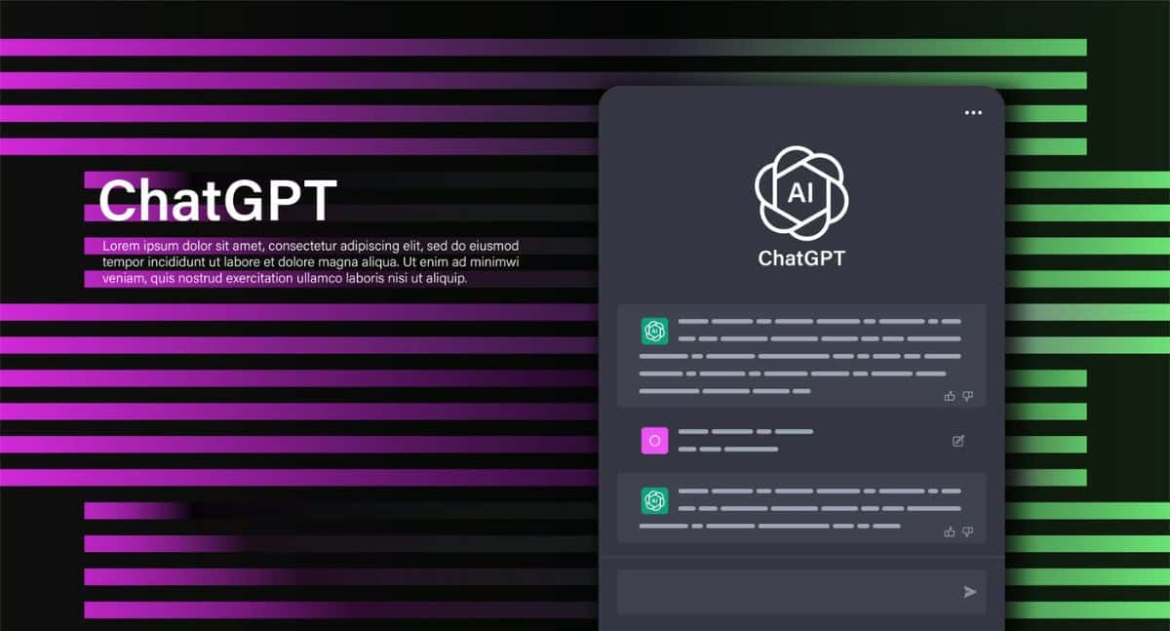

Slide 2
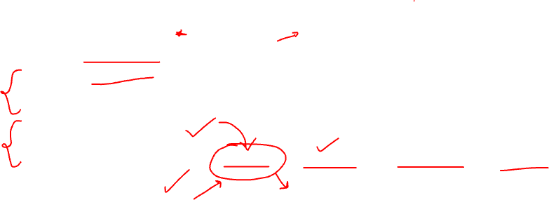
Agenda
ChatGPT Introduction
ChatGPT Prompts
ChatGPT Plus features
ChatGPT Architecture
Advance NLP concepts used in GPT
Advance transformer concepts used in GPT
Large Language Models
Integrating OpenAI api
Projects using OpenAI api : Chatbots, translators, summarization, Q&A

Slide 3
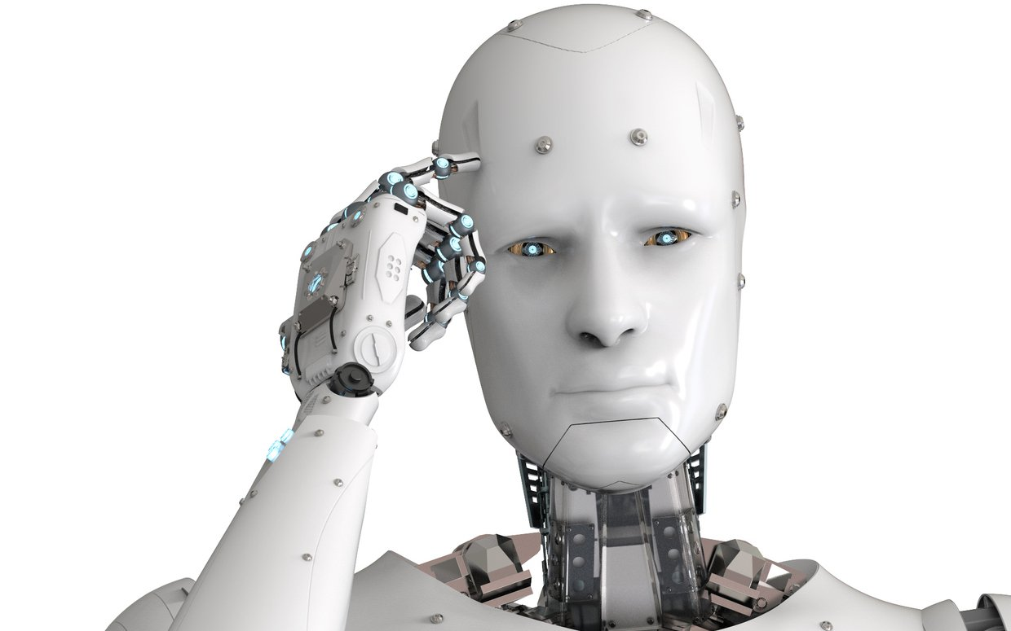
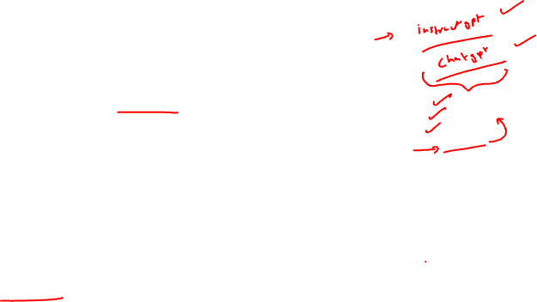
AGI
AGI (Artificial General Intelligence) refers to highly autonomous systems that possess human-like cognitive capabilities, enabling them to understand, learn, and perform tasks across diverse domains with the same level of proficiency as humans.
OpenAI is an AI research and deployment company. Our mission is to ensure that artificial general intelligence benefits all of humanity.

Slide 4

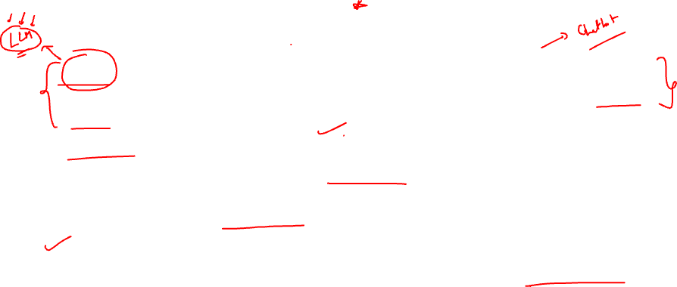
GPT: It accepts text, and generates human like text by predicting the next word in a sequence based on the context of the input. (text to text)
DALL-E: DALL-E is a neural network-based model developed by OpenAI. It is designed to generate images from textual descriptions using a combination of unsupervised learning and a large dataset of text-image pairs. (text to image)
Whisper: It is a versatile speech recognition model that can transcribe, identify and translate multiple languages.(Audio to text)

Slide 5

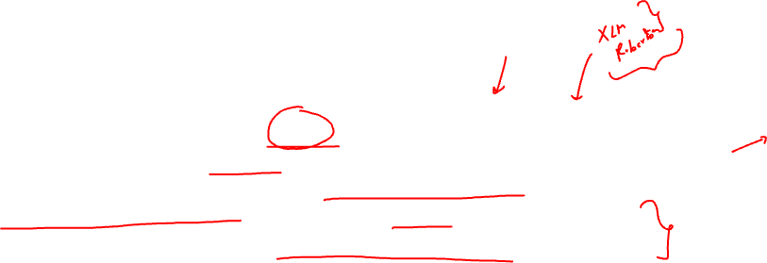
ChatGPT
ChatGPT is a variant of the GPT (Generative Pre-trained Transformer) model developed by OpenAI. It is specifically designed for generating human-like text responses in a conversational manner. Trained on a vast amount of diverse data from the internet, ChatGPT can understand and generate coherent and contextually relevant responses to user queries or prompts.

Slide 6
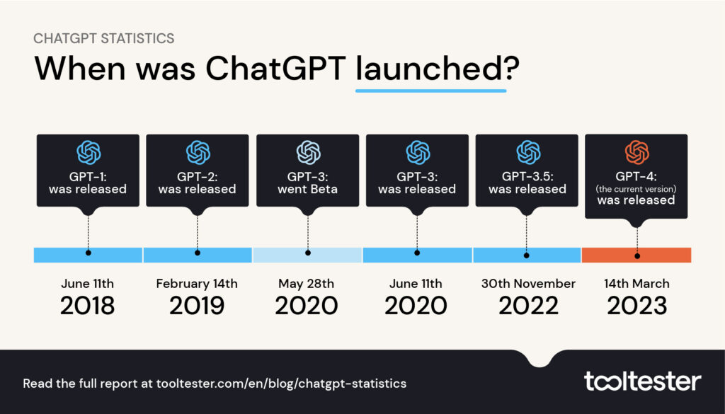
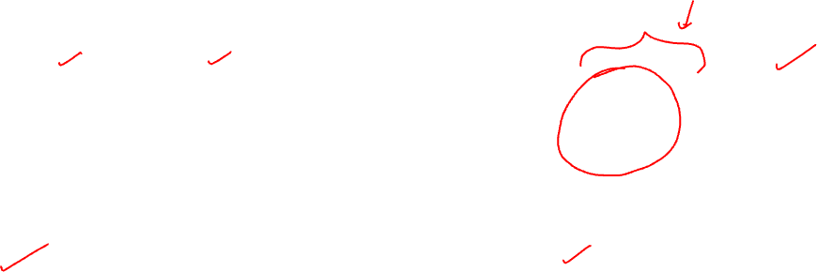

Slide 7
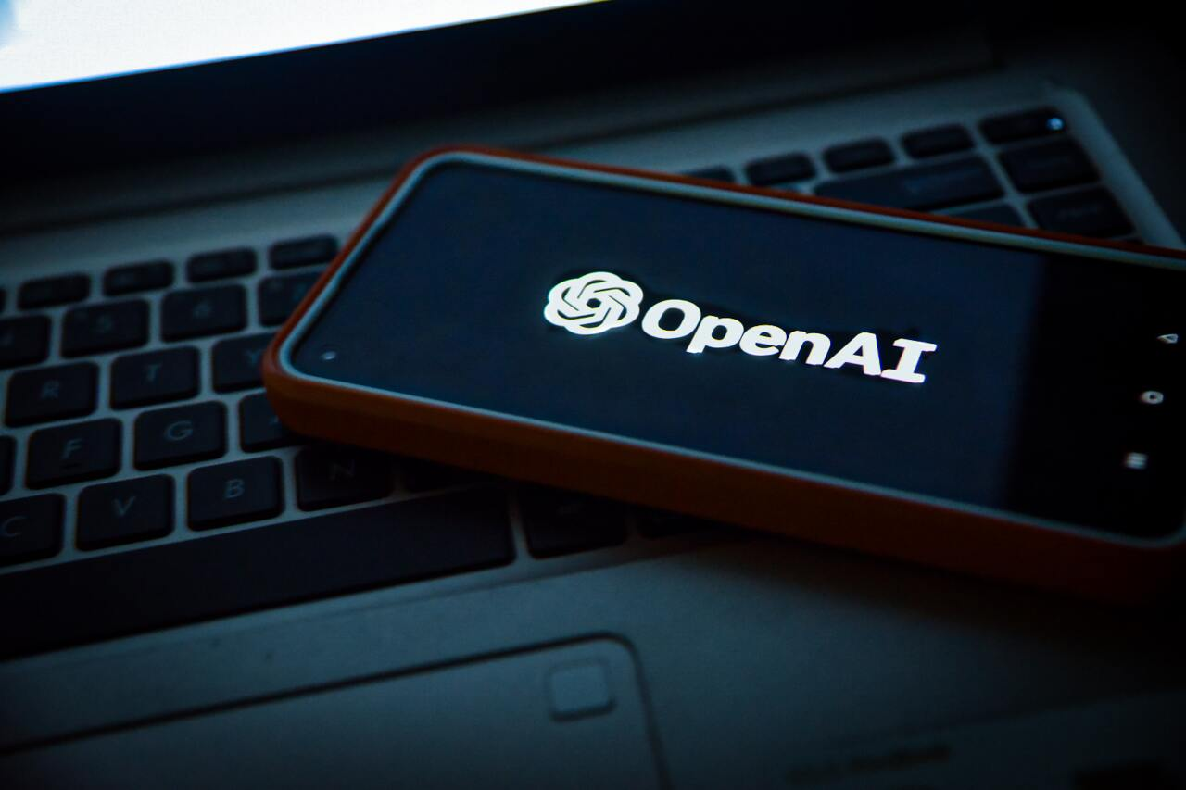
ChatGPT integration by Market leaders

Slide 8

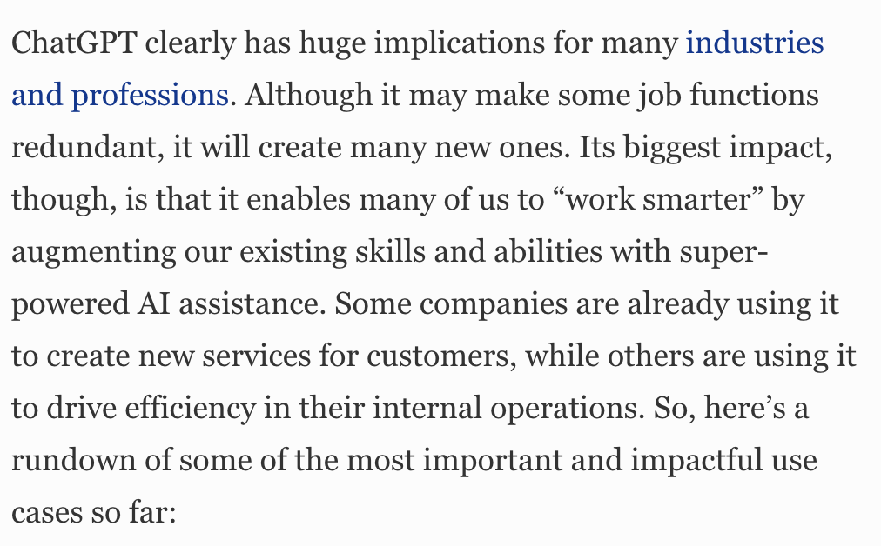


Slide 9

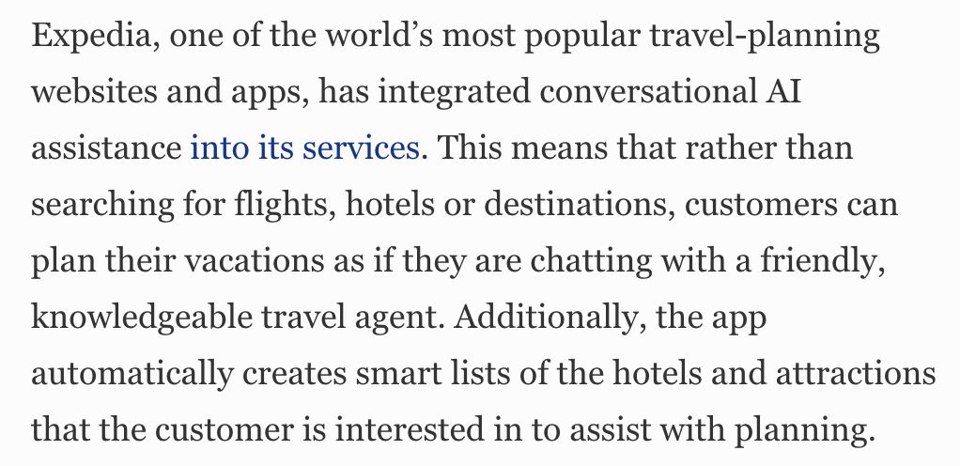
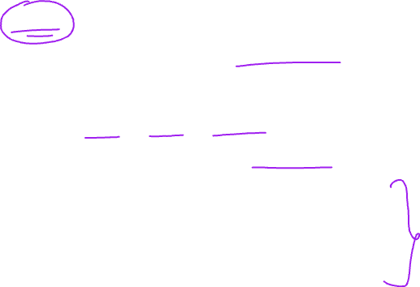

Slide 10
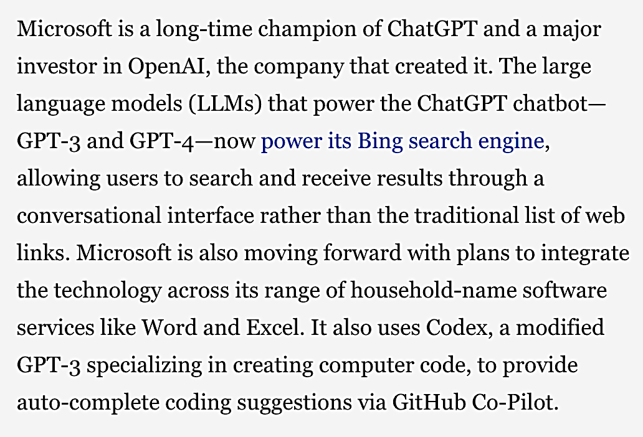
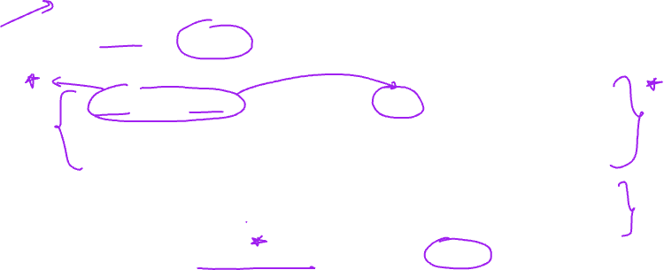

Slide 11
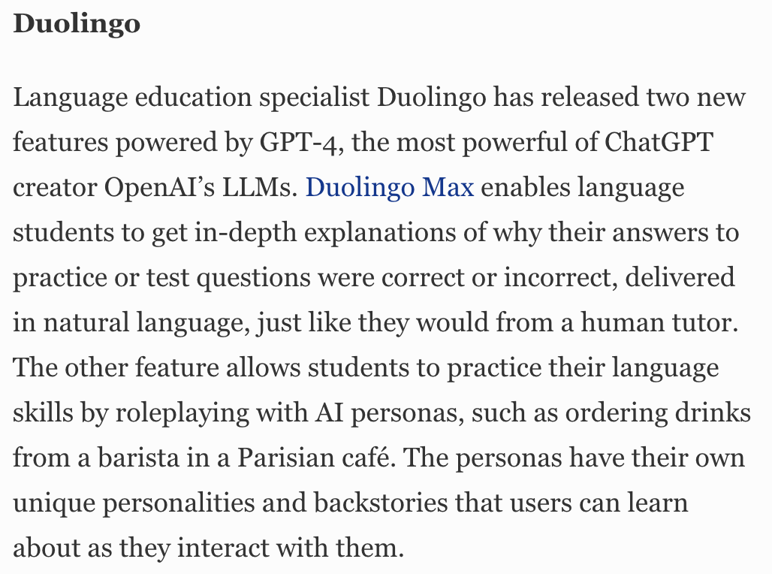

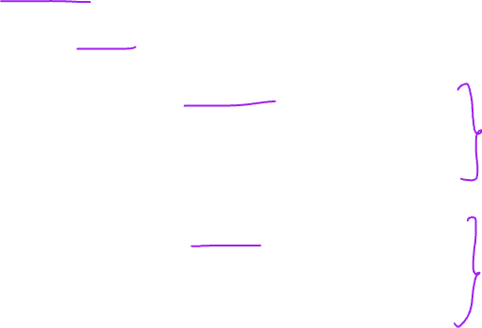

Slide 12
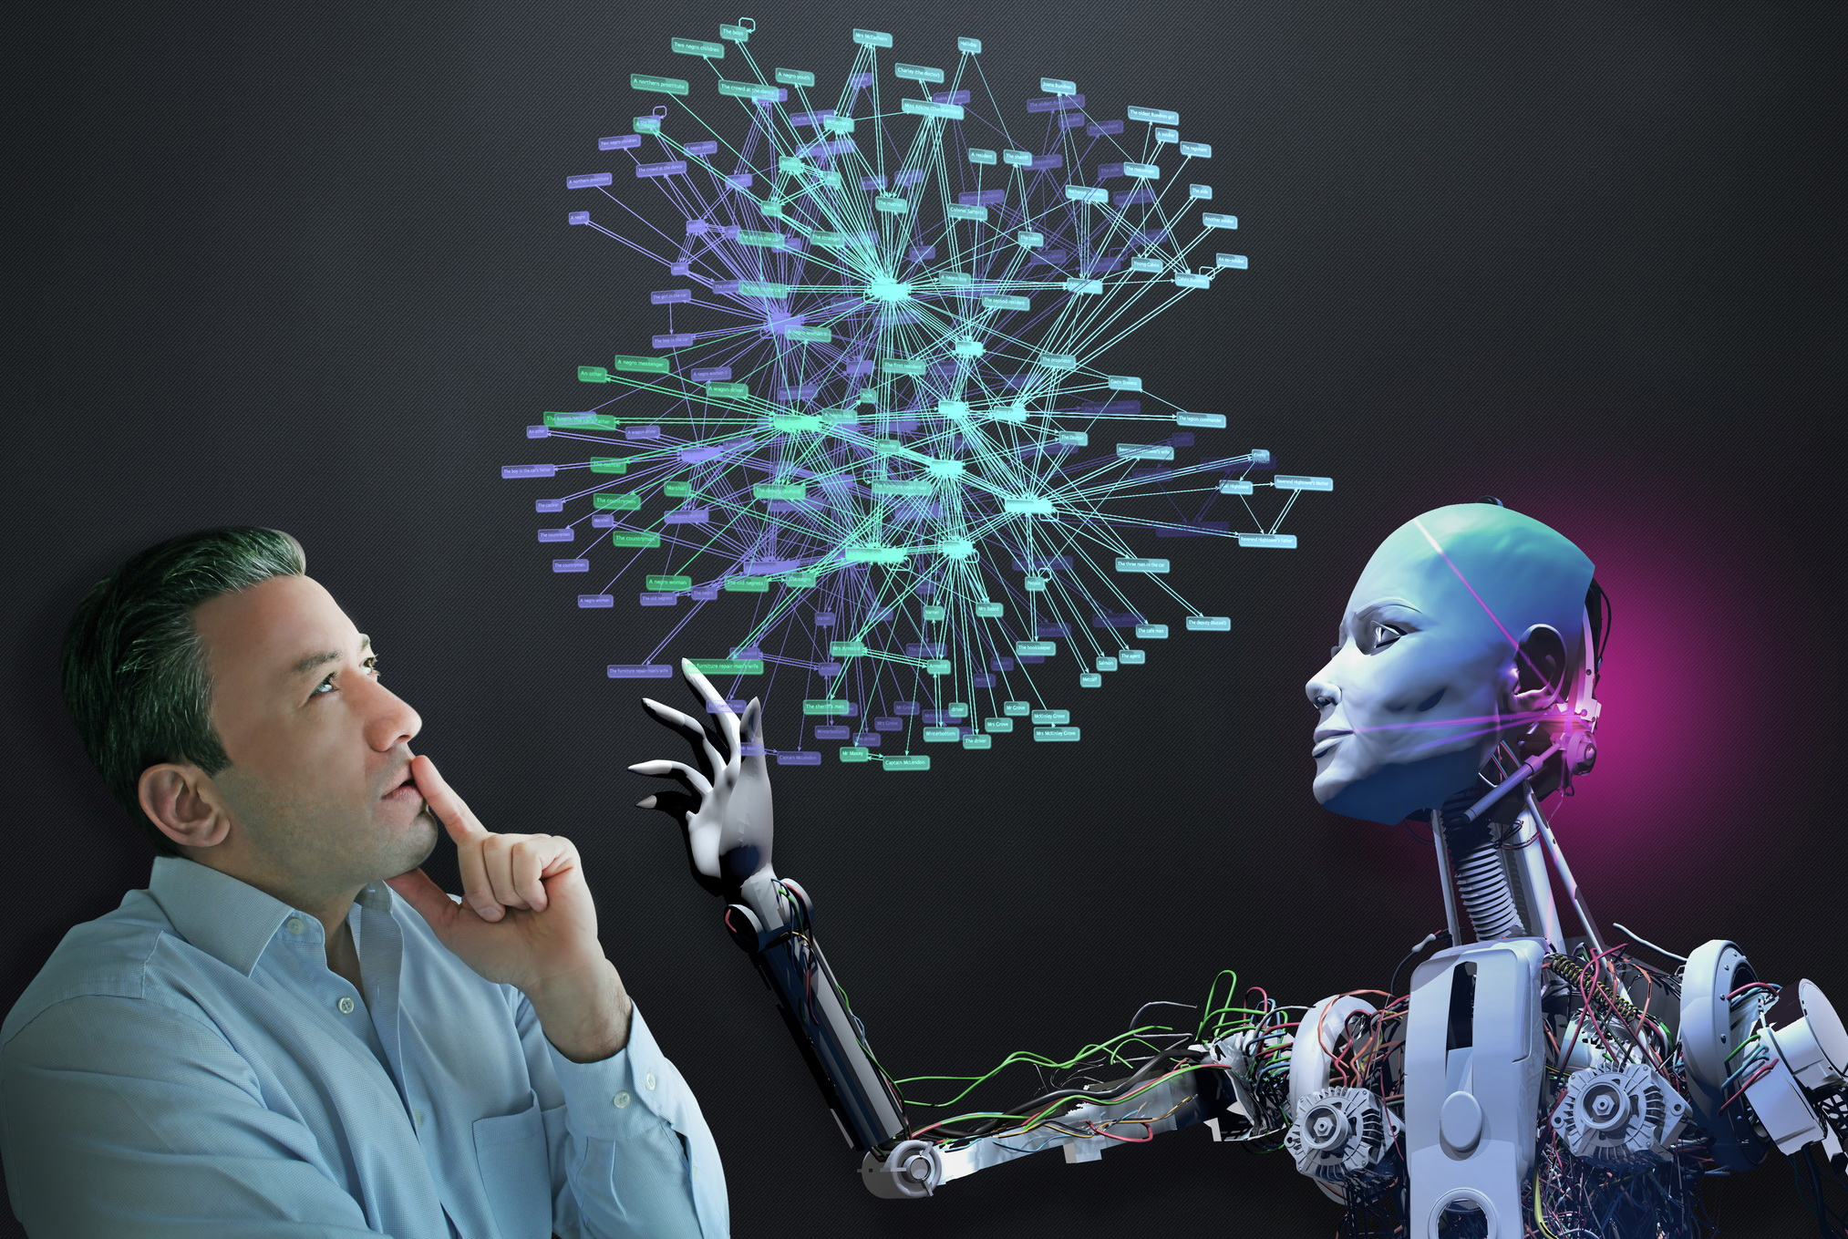
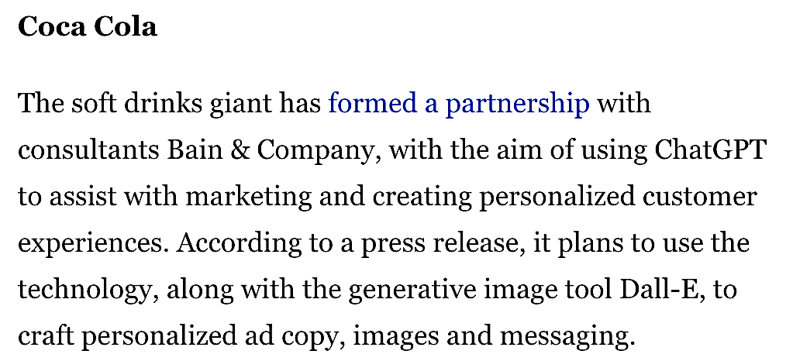


Slide 13
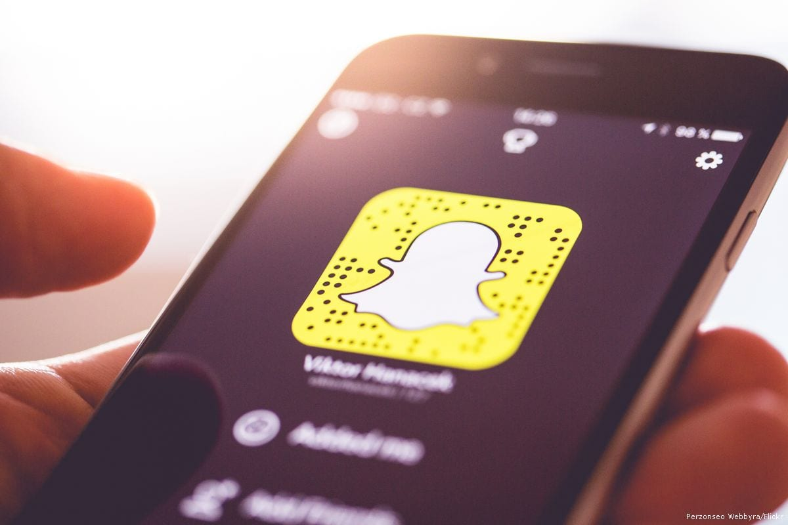
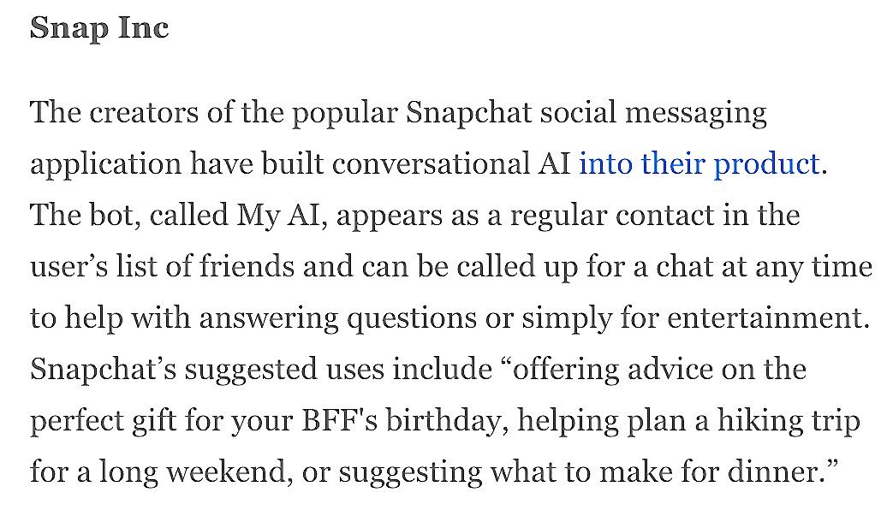


Slide 14
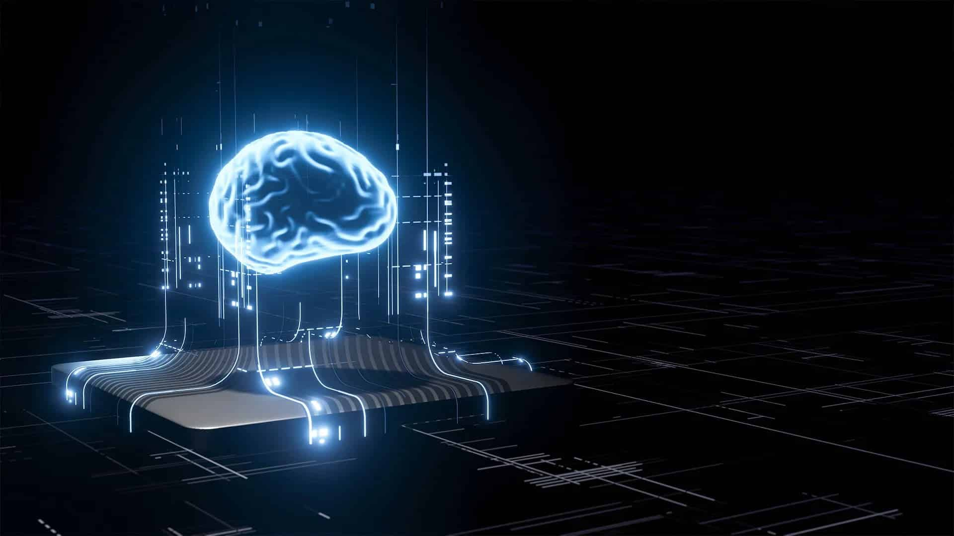
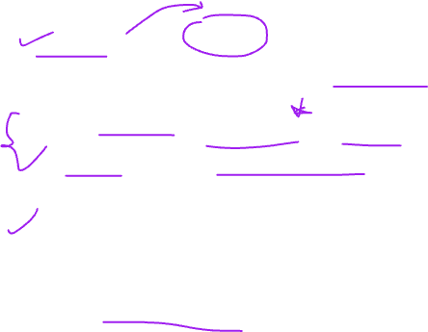
Features offered by GPT plus
GPT Plus used GPT 4, which an improvised version made by OpenAI.
It can file suits, sit for exams, make websites and do impressive work.
GPT – 4 can change how technology is used.
It has low response time.

Slide 15
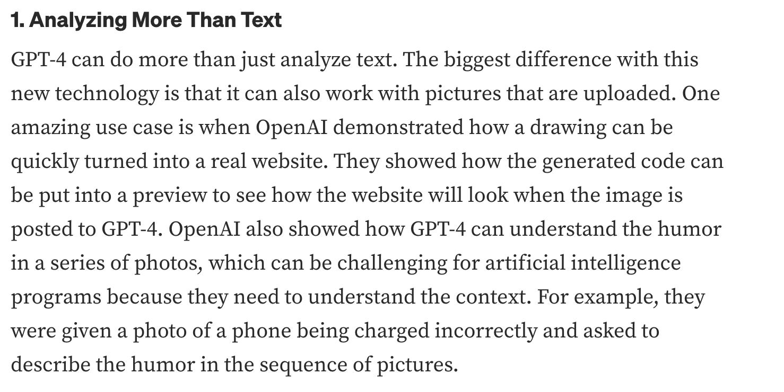
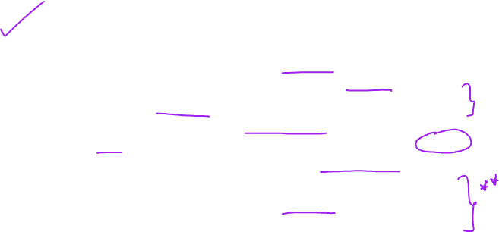

Slide 16
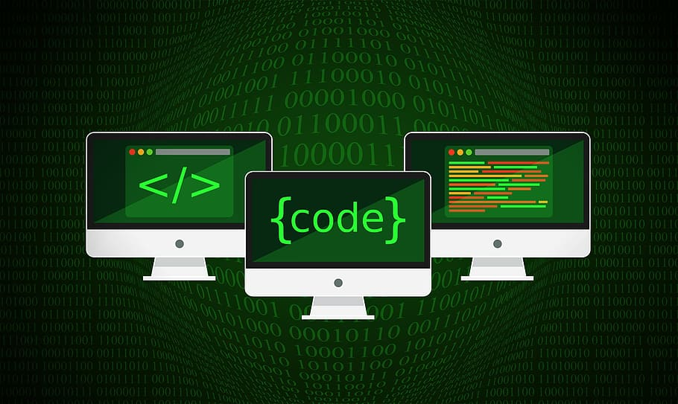
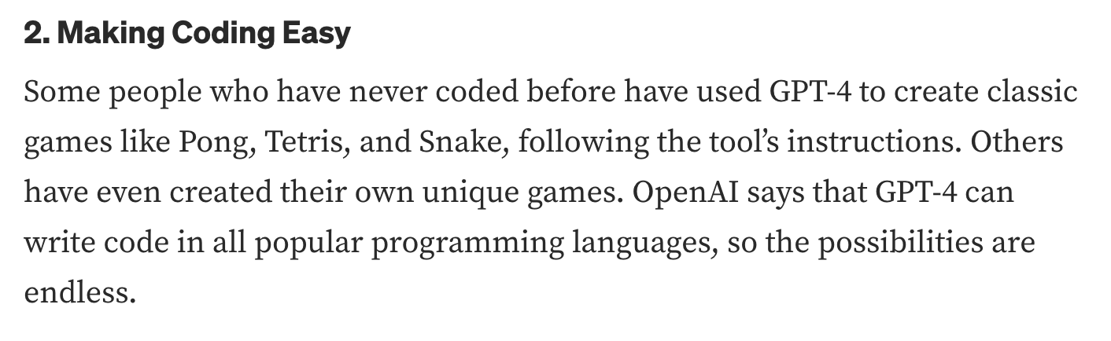
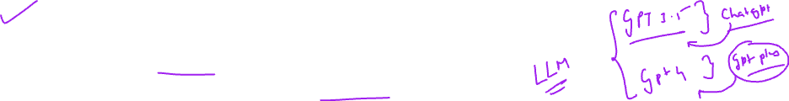

Slide 17
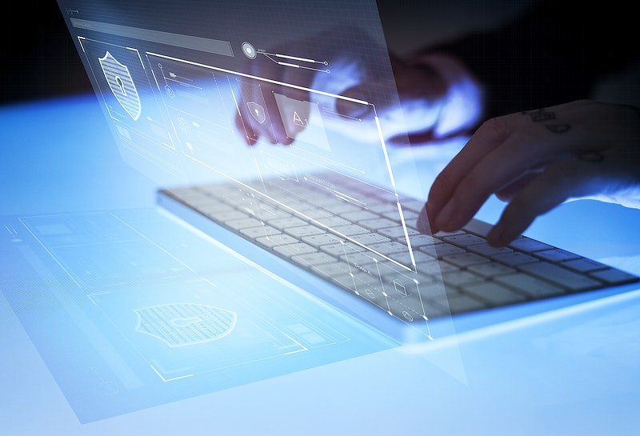
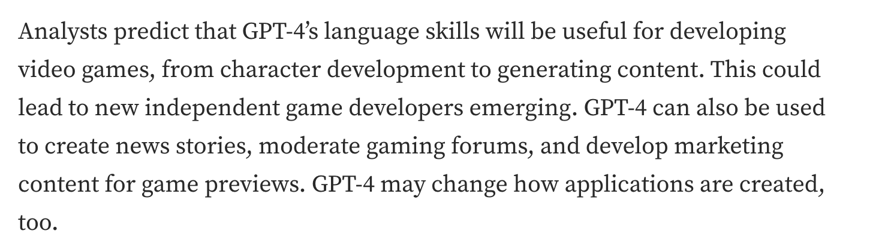


Slide 18
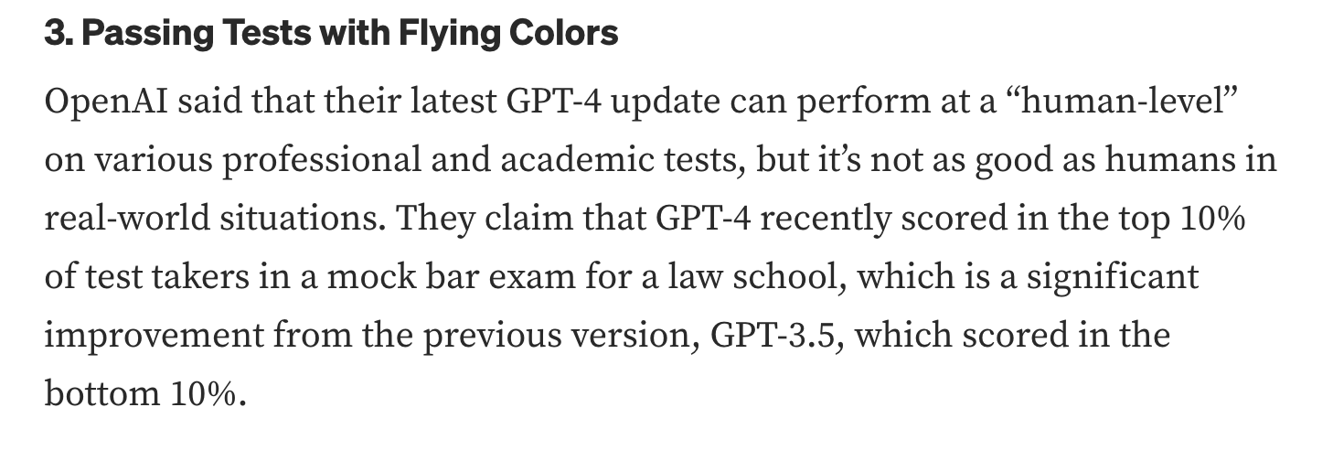

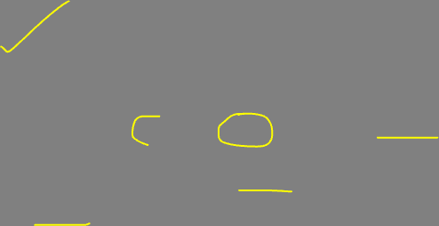

Slide 19

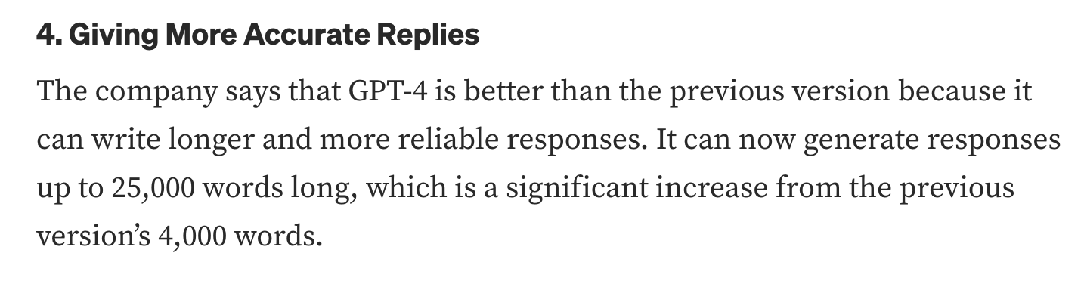
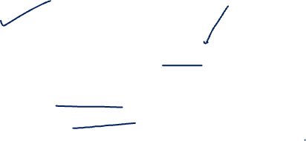

Slide 20
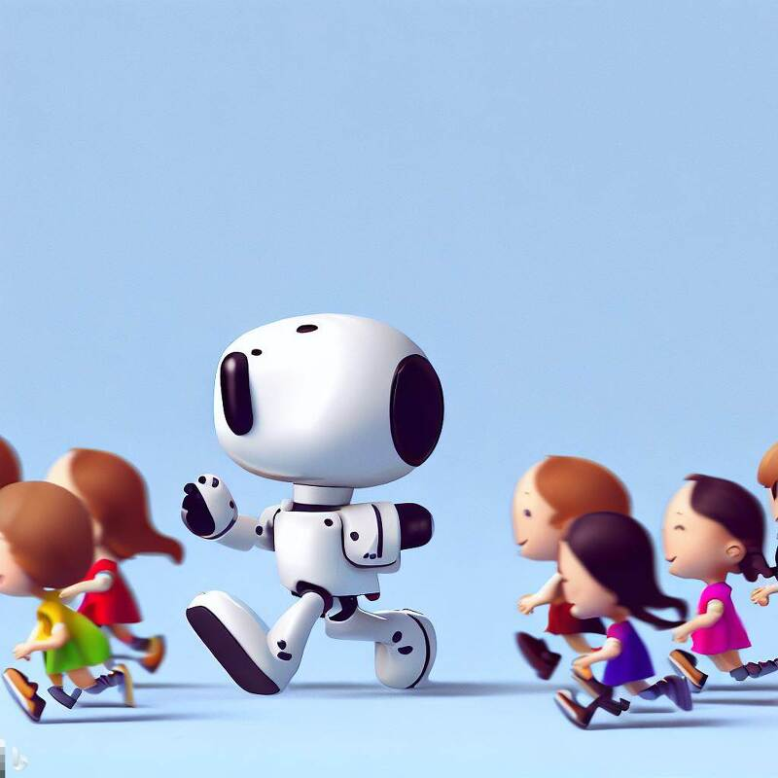
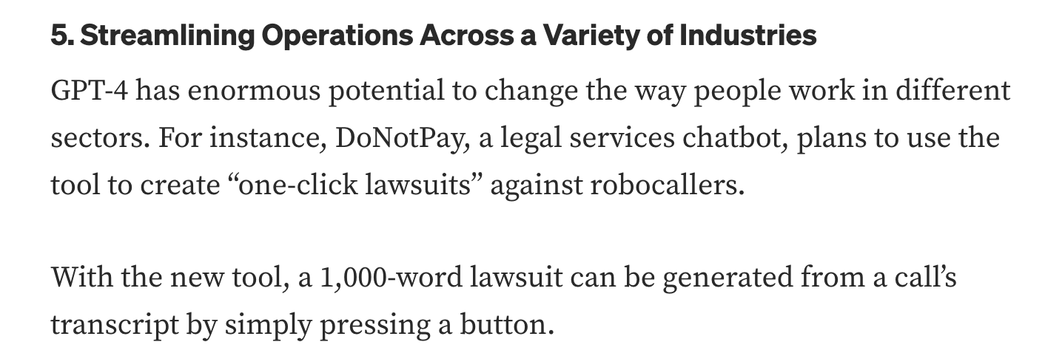


Slide 21
Hands on
https://chat.openai.com/

